Slide 1
NSI Board Report
CWE NSI Board MEETING
January 2024
Prepared By: Sarah Wickenhauser

Slide 2
Agenda
Call to order
Meeting Minutes approval – vote
Financial Report – vote
2024 Board of Directors - vote
NSI Staff Reports

Slide 3
Meeting Minutes – December 2023

Slide 4
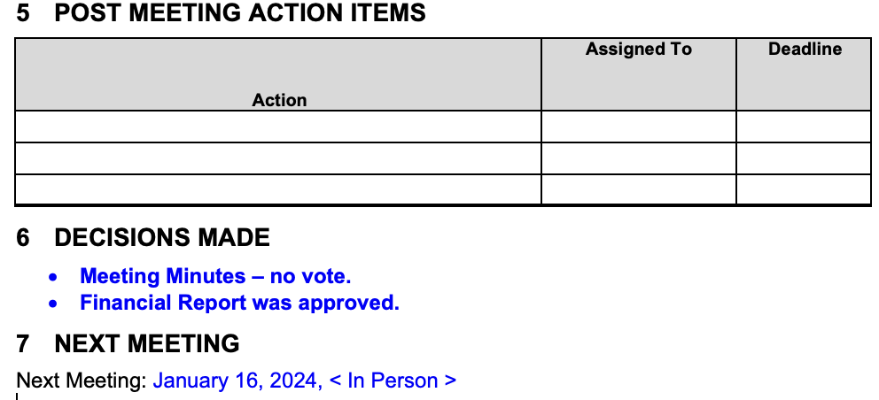
Meeting Minutes – December 2023

Slide 5
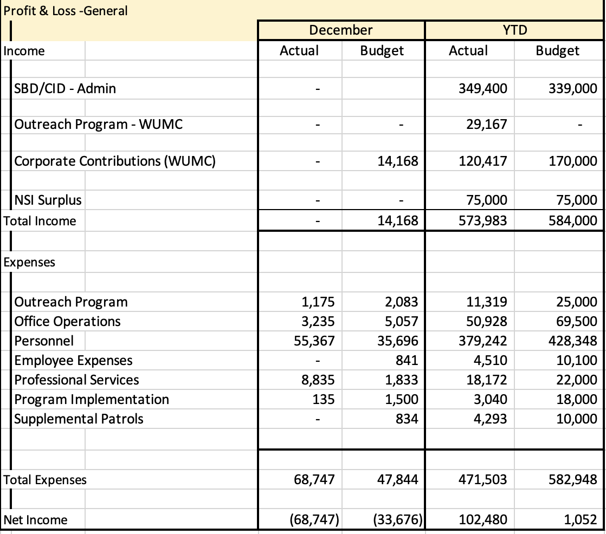
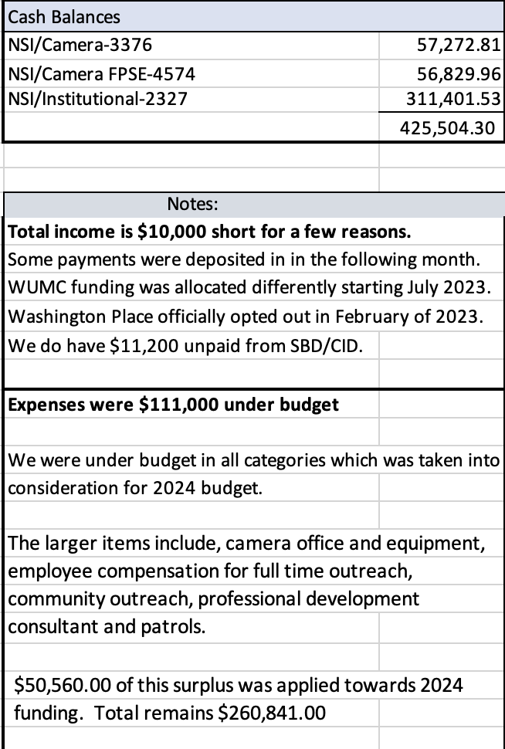
Financial Report – December 2023

Slide 6
NSI 2024 Board of Directors
Nominations -Vote
President – Yusef Scoggin
Vice President of Finance – Brian Phillips
Secretary – Jim Dwyer

Slide 7
NSI Updates
NSI contracts were sent out. Once approved and signed I’ll send out invoices.

Slide 8
Reports
Outreach Report
Camera Report
Executive Director Report

Slide 9
CWE NSI Executive Director Report January 2024
Jim Whyte
The Central West End Neighborhood Security Initiative
447 N. Euclid Ave, St. Louis, MO 63108
jwhyte@cwensi.com
314.454.5808

Slide 10
Updates
Jim Dwyer and I attended the town hall security event held at the Urban League on Monday, 01/08/24. The event was very well attended, and the panel included the Director of Public Safety, Circuit Attorney, Dr. Punch, President of the Board of Aldermen, Chief of Police, and James Clark.
I met with Nathan Vickers, reporter for KMOV, to discuss more positive stories in 2024.
Michele Prevedel and I visited Covenant House and meet with Yusef Scoggin for a tour of the facility and program.
Michele and I met with Samantha Stangl, Executive Director, House Everyone STL. They have the contract for distributing money on behalf of the Federal, State and City of St. Louis to service providers in the region.

Slide 11
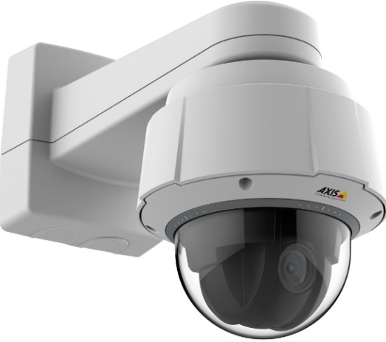
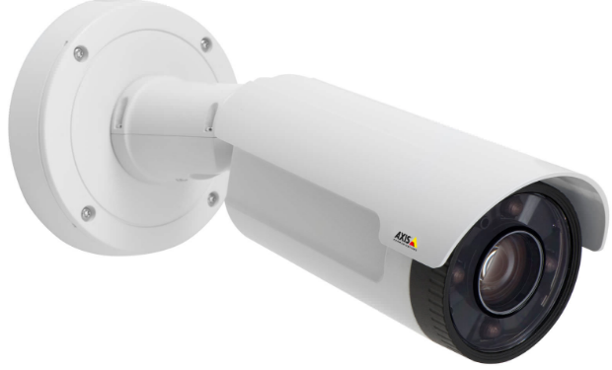
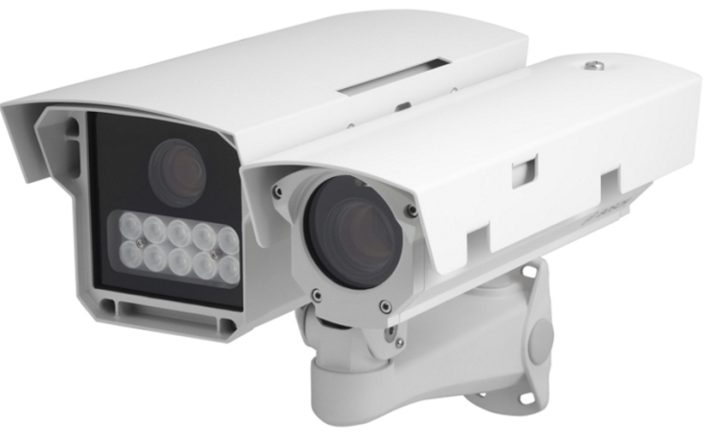
NSI Camera Project
January 16, 2024

Slide 12
Camera Management Information:
The Central West End neighborhood has 31 camera sites with 174 cameras having 278 views and 1 Flock camera.
DeBaliviere has 6 sites with 40 cameras having 68 camera views.
FPSE has 13 sites with 57 cameras having 133 camera views and 4 Flock cameras.
Loop East: (2) Camera sites with 10 cameras with 26 camera views.
Total Number of Camera Sites: 52
Total Number of Cameras: 281
Total Number of Camera Views: 505
Total Number of Flock Cameras: 5

Slide 13
Pending Camera Projects
5600- 5622 DeBaliviere- Replace/ upgrade displaced cameras on building. Upgrade/ add additional Cameras. (Complete)
4255 West Pine (Rejis)- Upgrade external cameras on building and install pole at intersection- On Hold.
4502 Laclede- Upgrade and install new cameras at this site. (in process).
40 N. Euclid- Replace NVR and upgrade camera. (Complete)
#26 Maryland Plaza- Total upgrade to this system. (Complete)
4398 and 4400 Chouteau- Establish 2 new camera sites. (Complete)
4511 West Pine- Upgrade cameras & Internet at this site. (Start Date 1/15/2024).
4321 Chouteau- Establish a new camera site. (Equipment has been delivered. Waiting on construction)
Recommendation for Camera upgrades and establish new sites in the CWE South SBD and Euclid South CID.

Slide 14
Pending Projects continued
4503 McPherson- Due to the overgrowth of trees and bushes conduct a site visit. Upgrade and install additional cameras at this site. (Completed).
4909 Laclede- Upgrade cameras at this site. Walk through scheduled 11/21/2023. (Complete. Proposal Submitted/Pending)
4949 West Pine- Upgrade cameras at this site. Walk through scheduled 11/21/2023. (Complete. Proposal Submitted/Pending)
398 N. Euclid- Establish a new camera site at this location. (Walk through completed. Proposal Submitted/Approved)

Slide 15
Camera Review Information
From December 18, 2023 to December 31, 2023 (18)
From January 1, 2024 to January 15, 2024 (4)
Total camera reviews: 22
Total arrests relative to reviews: 36
Total wanted(s):
Total vehicle wanted(s):

Slide 16
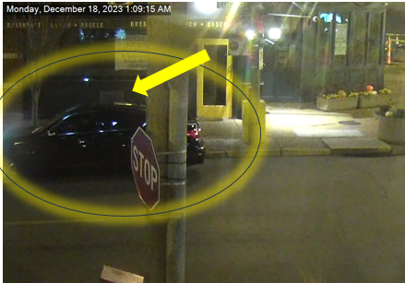
23-057460 Theft of Postal Services on 12/18/2023 at approximately 1:00AM
The NSI was contacted relative to an open mailbox that was at the intersection of Euclid and Laclede.
The NSI conducted a camera review and observed a dark blue or black possibly Infinity travel north on Euclid, pull next to the mailbox at approximately 0108hrs.
The passenger exited the vehicle and appeared to use a key and removed the property from the mailbox.
The passenger was wearing black sweatpants, black hoodie with white writing on front, white socks, black and white flip flops, and was wearing a mask.
The vehicle then continued north on Euclid passing Lindell at 0110AM. It should be noted The NSI has a LPR camera facing North on Euclid at Lindell. The RTCC was contacted and advised of same.
The vehicle then stopped at McPherson and Euclid and the passenger again exited and used a key to open the mailbox and remove the items from same.
The vehicle was last scene traveling east on Pershing out of sight at 0114AM
The video was downloaded and awaiting a complaint number and the Postal Inspector will be notified.

Slide 17
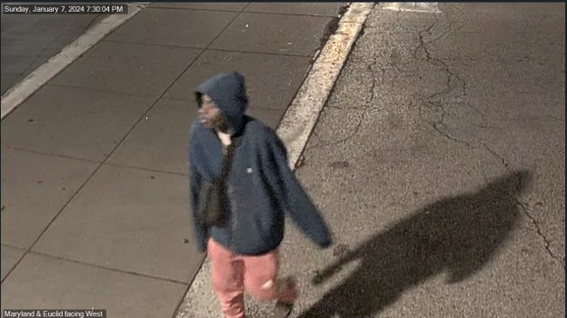
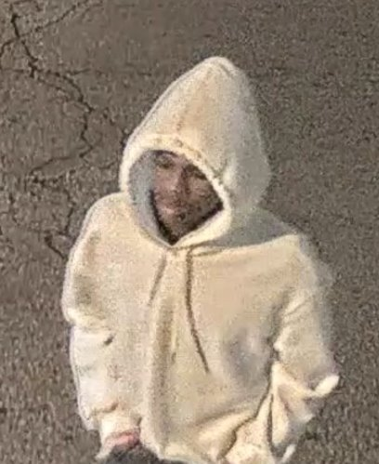
24-001123​ Attempt Stealing of a M.V. 1/7/2024 @ 7:16PM
The NSI was contacted relative to an Attempt Stealing of a Motor Vehicle that occurred on the above date and time.​
The NSI reviewed the cameras from 4497 Pershing and observed the suspects.​
Suspect #1 B/M 14-18 years of age, wearing a blue hoodie, orange sweatpants, with white writing down the right pants leg, black and white Nike Dunk tennis shoes, carrying a shoulder bag.​
Suspect #2 B/M 14-18 years of age, wearing a white hoodie with red writing on the back, black pants, with white Nike Air Force 1’s tennis shoes.​
At approximately 7:04PM, the suspects sat on a stoop in front of 4497 Pershing until they entered the parking lot of this building. ​
Suspect #2 was observed looking into several vehicles on this lot while suspect #1 stood watch.​
Both suspects traveled west in the 4400 block of Pershing until reaching Euclid, then South toward Maryland, and East on Maryland until out of sight.​
The NSI downloaded the video and will provide to the 5th District.​

Slide 18
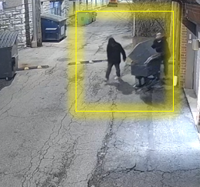
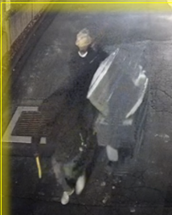
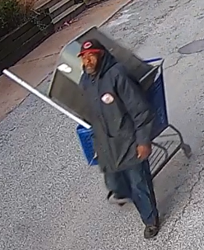
STOLEN AC UNIT from 4444-4464 LINDELL 12-18-2023 01/02/2023 ,23-057809, 23-058568, 23-059299, 24-000385, 24-000488, 24-000477
The NSI was contacted by the victim Raymond Slay 4454 Lindell who advised his AC condenser units were stolen from his property buildings from 4444-4464 Lindell, by unknown suspects possibly 2 between the dates of December 18th, 2023, to January 02nd 2024 at approximately 6:30AM.
Slay advised he contacted the Police Department and reported the incident documented under complain numbers 23-057809,23-058568,23-059299, 24-000385, 24-000488, 24-000477.
Slay advised on 1/2/2024 District 5 arrested a suspect who was tampering with AC units.
A neighbor of Slay contacted the NSI and further advised another ac condenser (#6) was stolen sometime between 01/02/2023 to 01/03/2023.
On 1/4/2023 Slay provided additional camera footage regarding incidents to the NSI and to Detective Hines.
The NSI reviewed the footage and observed 3 possible suspects with shopping carts and a dolly utilizing a pruning sheer to cut the copper lines and electrical disconnect boxes to steal the units.
All three suspects appeared to walk in the alley east toward Newstead out of sight.

Slide 19
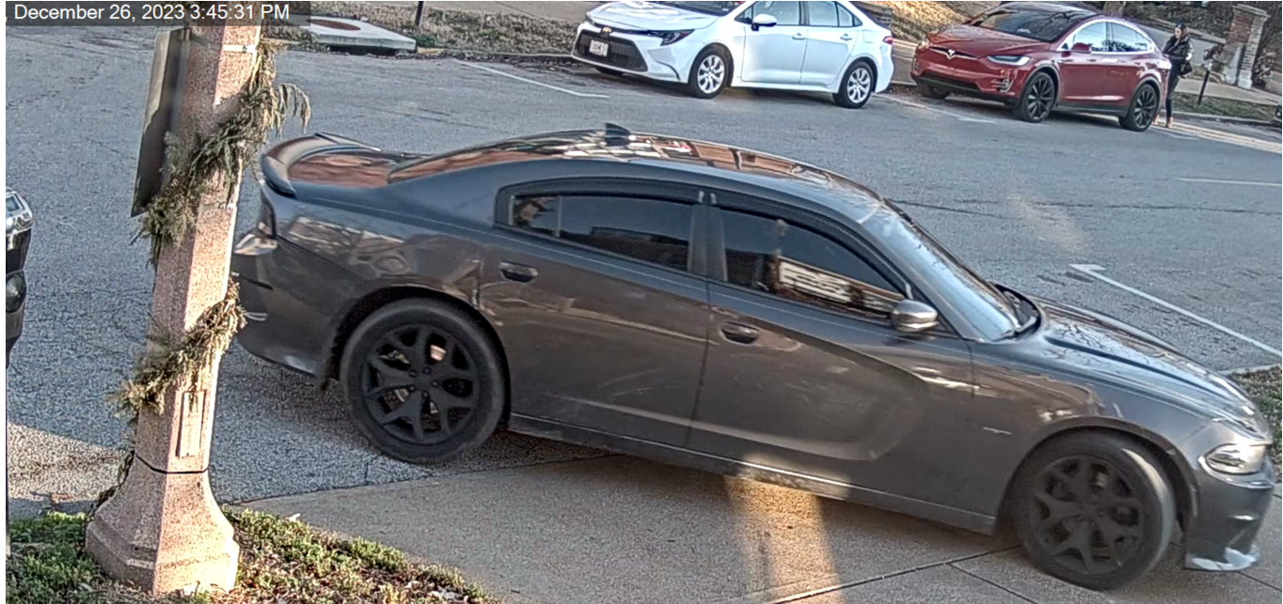
23-058639 UUW Flourishing/Destruction of Property 447 N. Euclid 12/26/2023 at approximately 3:45pm
The NSI received information relative to a “flourishing” incident on the parking lot located at 447 N. Euclid on 12/26/23 at 3:40pm.
Victim contacted J. Whyte and advised he saw a car pull onto the business parking lot and park next to his car. The victim then saw an occupant tampering with his car and he went outside and confronted the subjects.
Victim was flourished by the occupant seated in the rear driver’s side of the car.
The suspects drove off the parking lot after breaking the victim’s rear driver’s side window.
Suspect vehicle was seen driving south on Euclid toward McPherson

Slide 20
NSI Outreach Program Updates
Alvin Ferguson & Melissa Brown

Slide 21
54 Total Individual Engagements between Dec 15, 2023-Jan 7, 2024

Slide 22
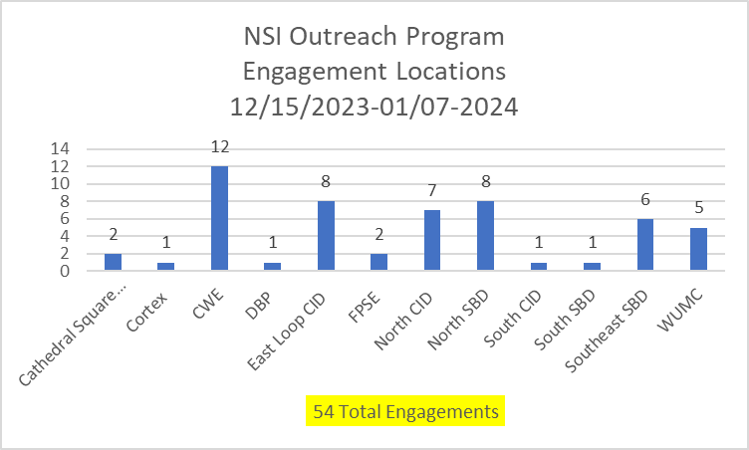
61 Total Individual Engagements between Nov 12-Dec 12, 2023

Slide 23
61 Total Individual Engagements between Nov 12-Dec 12, 2023

Slide 24
61 Total Individual Engagements between Nov 12-Dec 12, 2023

Slide 25
61 Total Individual Engagements between Nov 12-Dec 12, 2023

Slide 26
First Engagement with the family was on December 15, 2023
-Provided 3-night hotel stay
-Provided bus tickets
-Provided several local social service resources
-Provided encouragement and continuous outreach support
Both parents are now employed and staying at a motel on a weekly basis.

